Slide 1
AI in Bioinformatics: Will you Be the Pilot or the Passenger?
Tommy Tang
Youtube channel: Chatomics
Divingintogeneticsandgenomics.com

Slide 2
Agenda
What is AI in the context of Bioinformatics?
Introduction to AI coding agents
My Bioinformatics workflow using AI
Hands-on Demo using Claude Code for RNAseq analysis

Slide 3
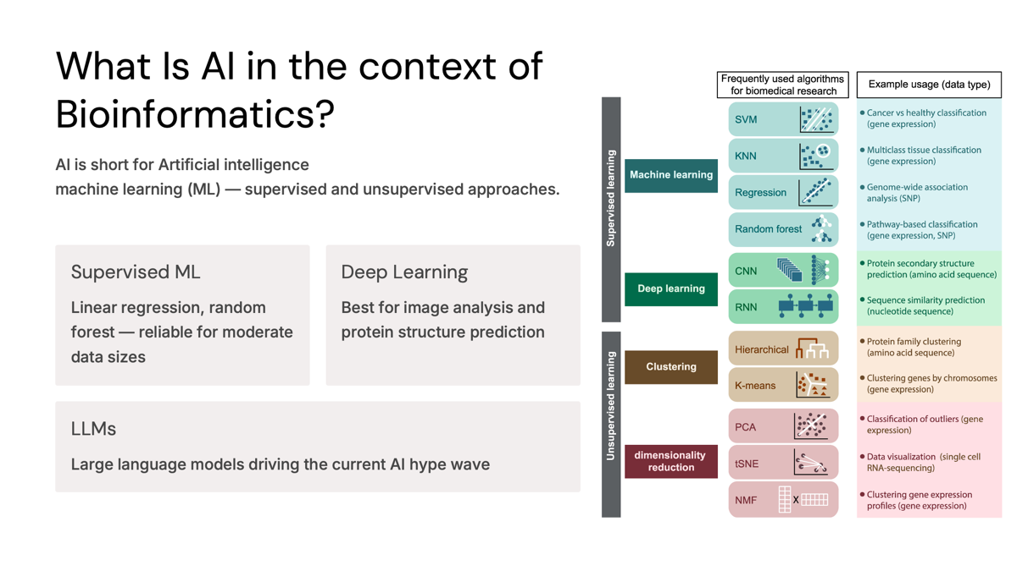

Slide 4
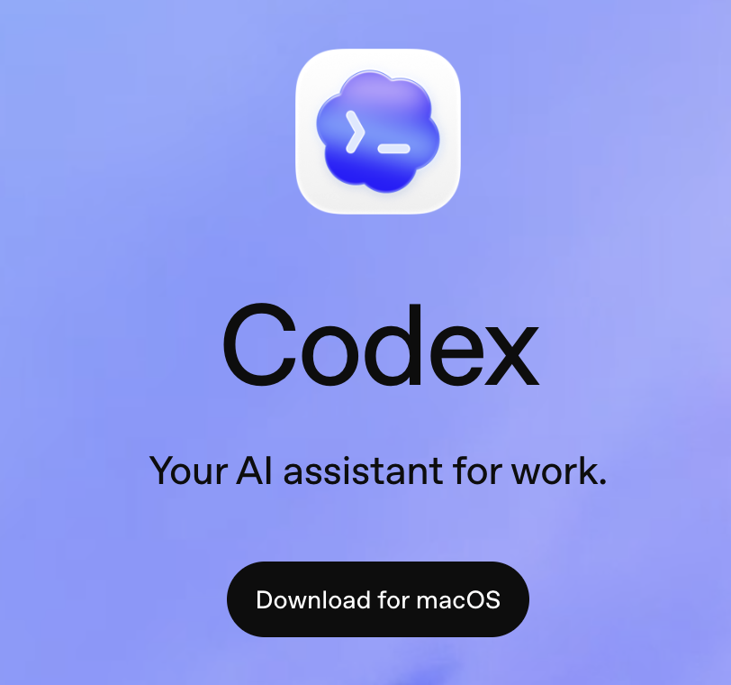
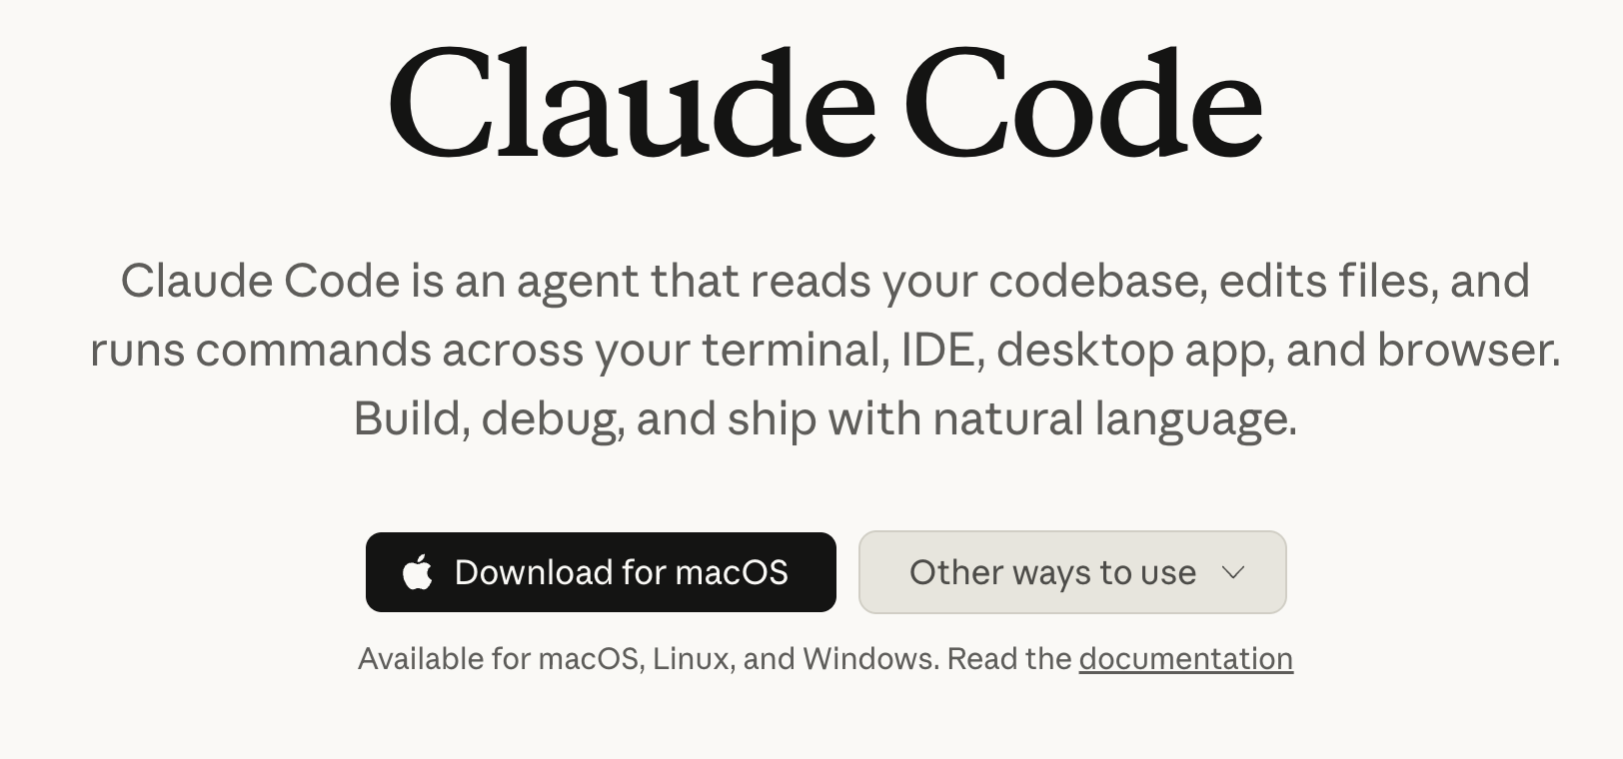
What is an AI coding agent?
Different from ChatGPT and Claude chat

Slide 5
Leverage AI to increase your efficiency
I can built a Shiny App in a few days.
Use Claude Code to build a website for yourself.
Use Claude Code as a thinking partner
Use Claude Code to implement the bioinformatics analysis

Slide 6
Foundation still (always) matters
“Producing the Code is cheap, understanding the Code is more expensive now” -Eric Ma
Use AI as a tutor to teach you those basics: Linux, Python/R and Biology.
Learn by doing. Work on a real project, make mistakes. Accumulate experience via time.

Slide 7
Unix commands
Unix commands and the Unix command-line interface have existed for over 50 years.
It is very powerful and efficient.
Most Bioinformatics tools run in command line. (Claude Code too!)

Slide 8
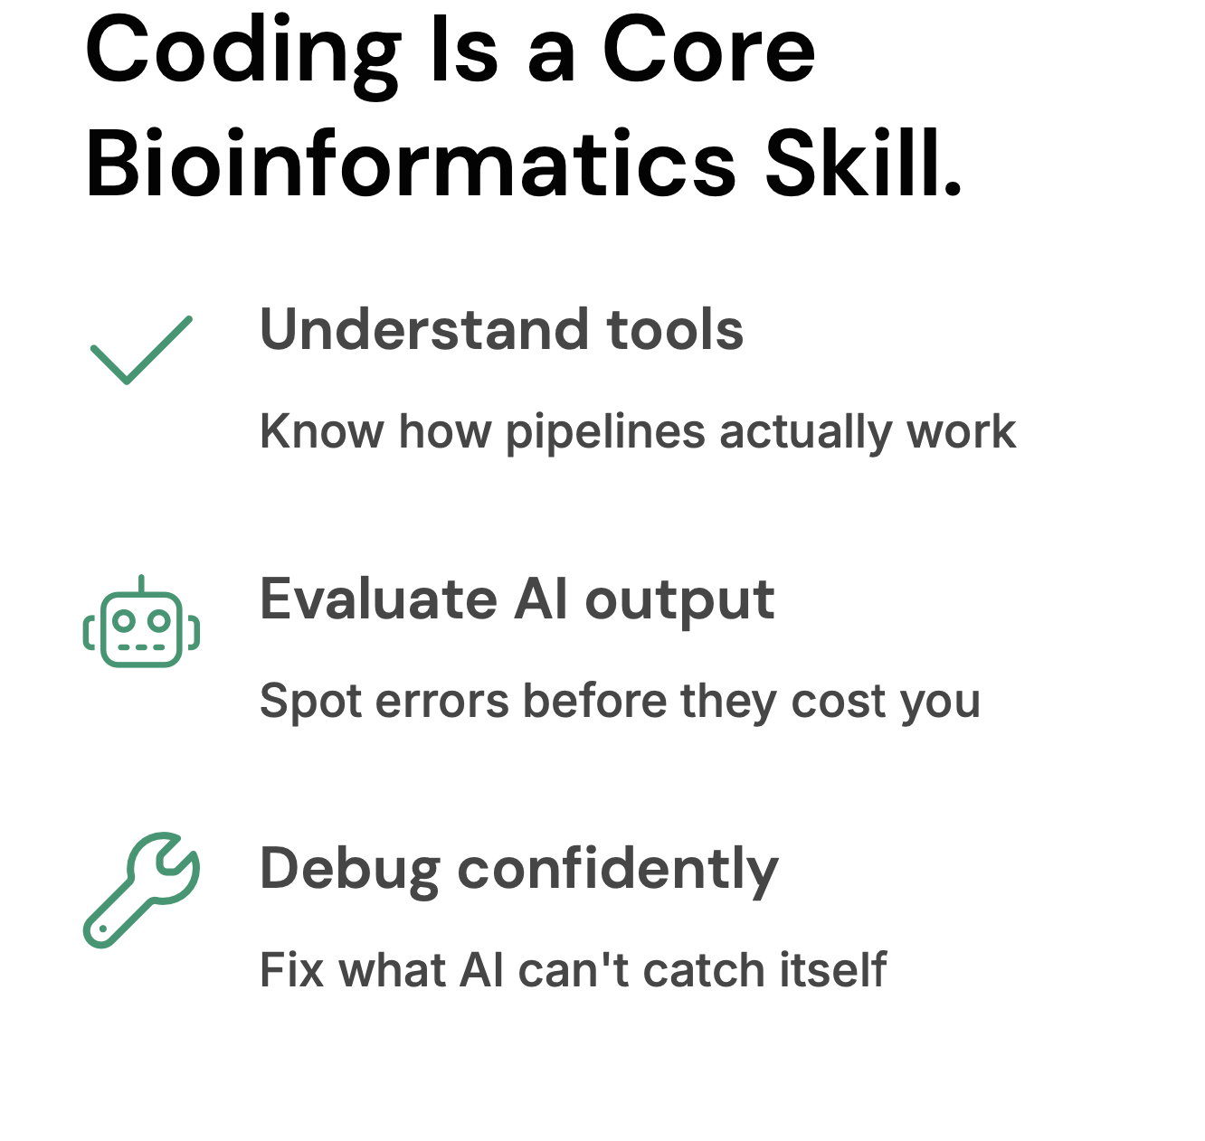
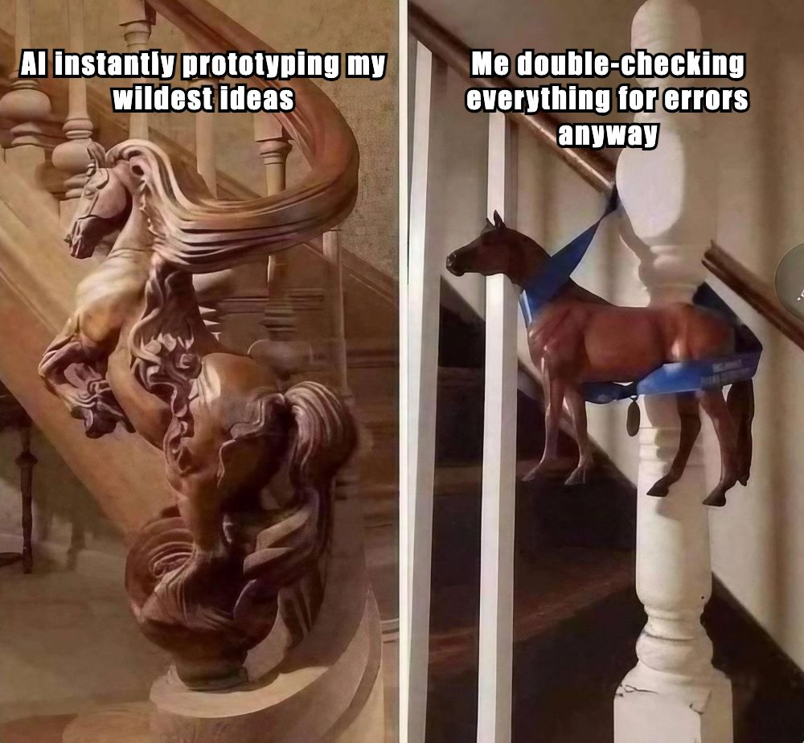

Slide 9
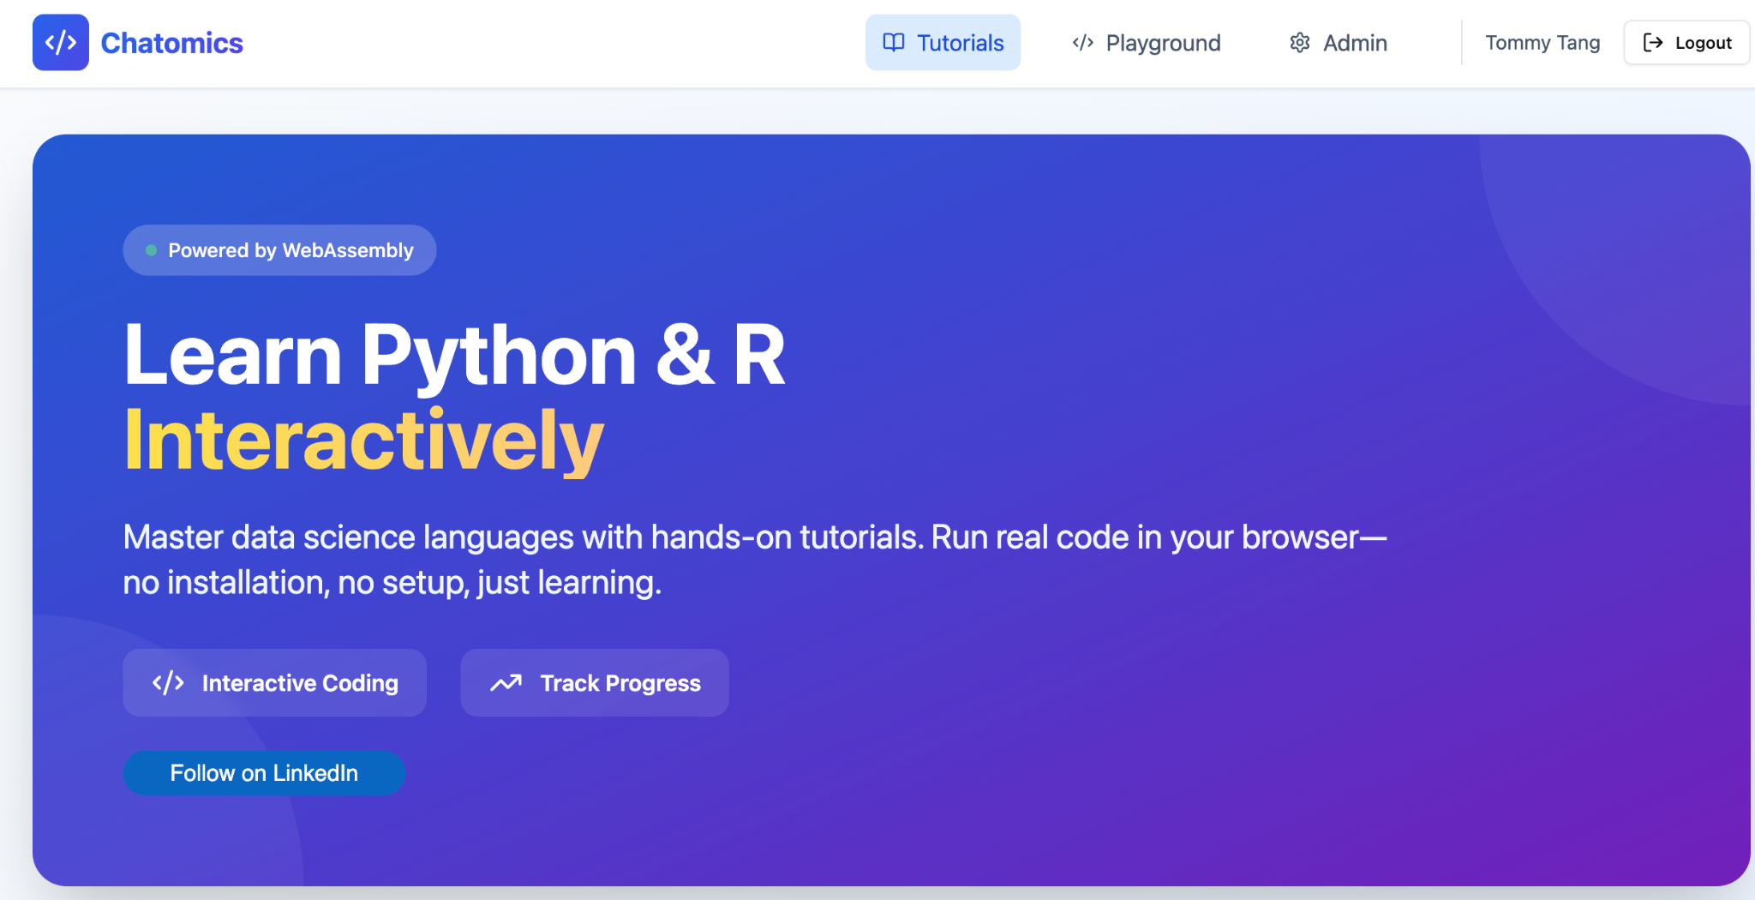
I vibe coded this app in a couple of days
https://chatomics-labs.base44.app/Home

Slide 10
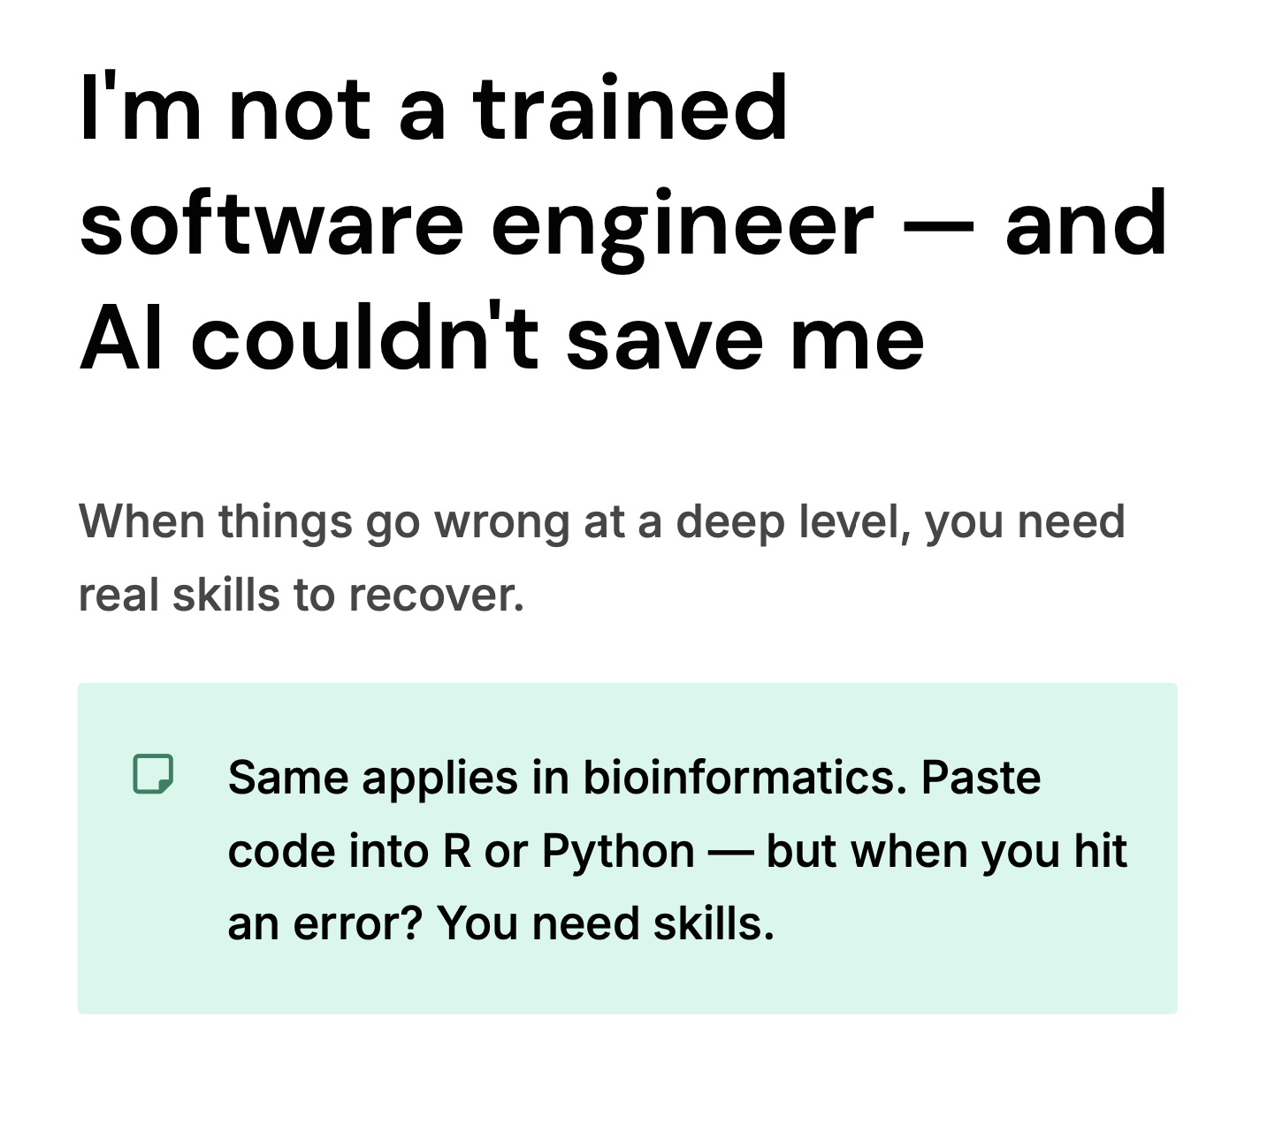
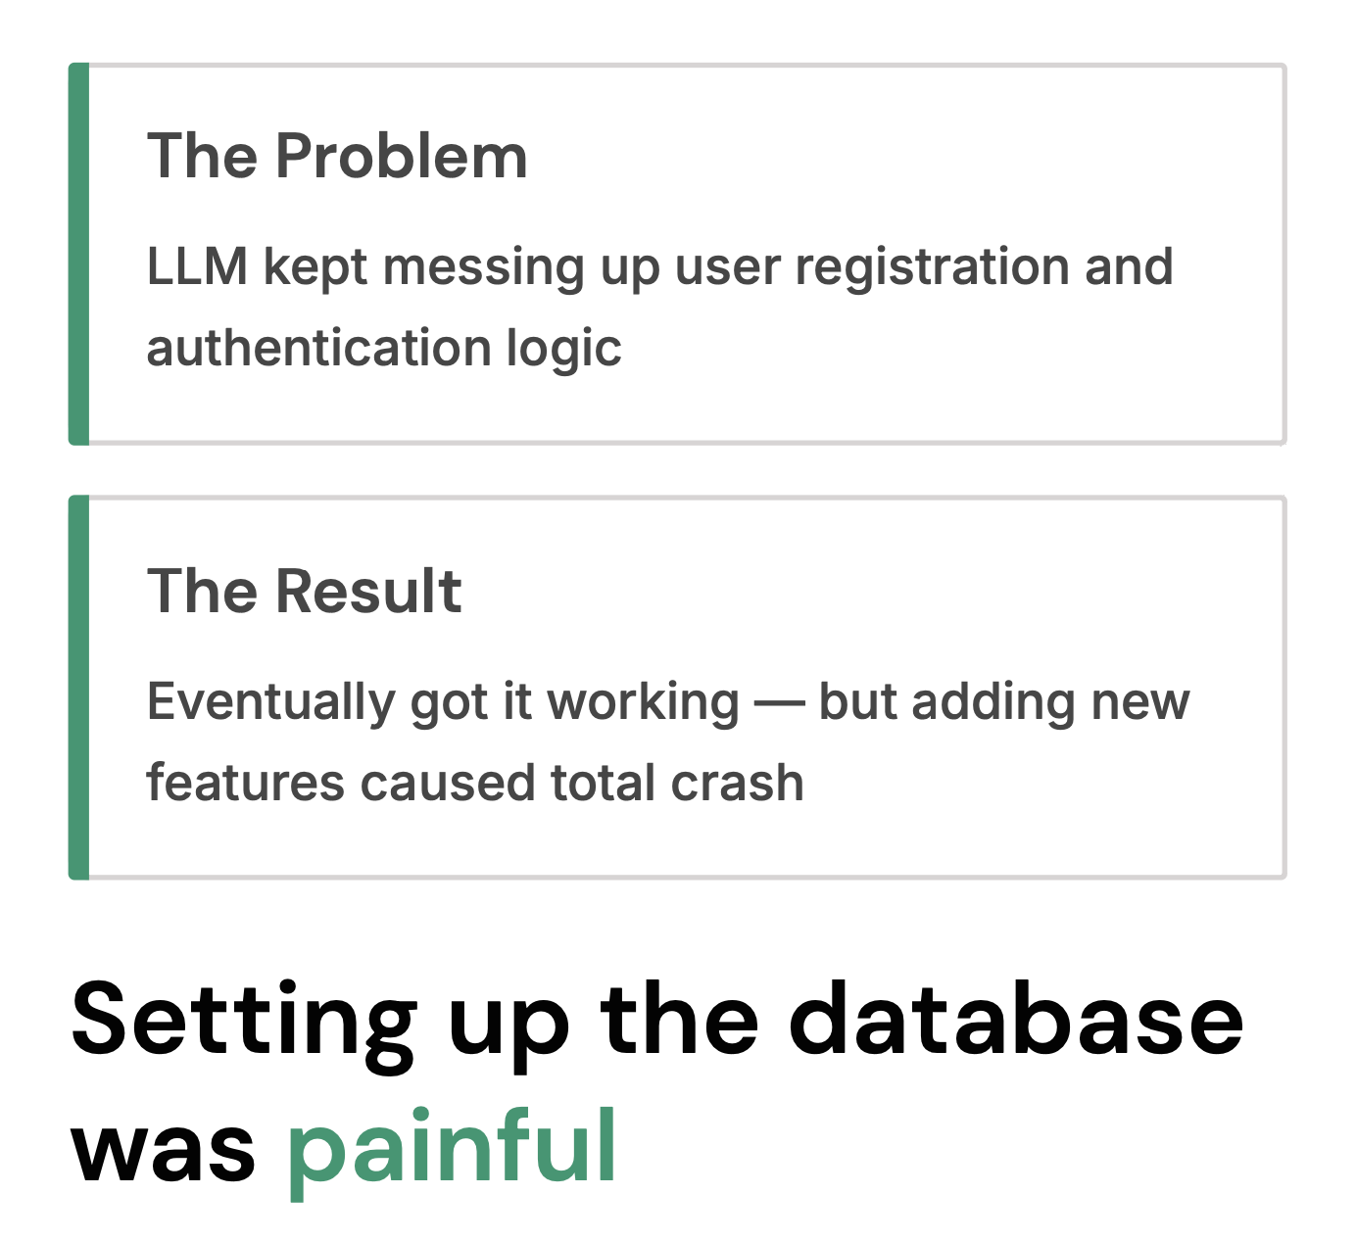

Slide 11
Your experience matters: spot the batch effect
PC2
PC2
cond1
batch1
batch2
cond1
cond2
cond2
batch1
batch2
PC1
PC1
https://www.youtube.com/watch?v=FgakZw6K1QQ
https://divingintogeneticsandgenomics.com/post/pca-in-action/

Slide 12
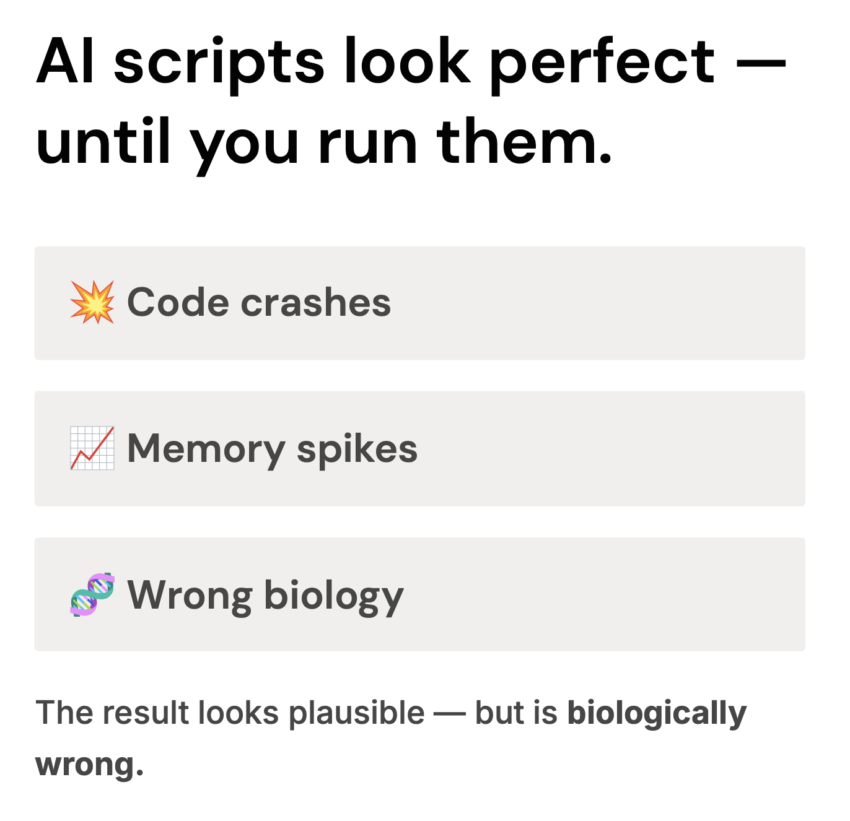

Slide 13
My AI workflow with Bioinformatics analysis
Start with a plan. (experimental design, biological context and questions to ask)
I specifically point Claude Code to my old scripts to mimic the style.
It generates Rmd file or Jupyter Notebook.
I run it line by line. Iterate when I see problems.
Commit it to github
Talk to biologists collaborators to understand the biological insight

Slide 14
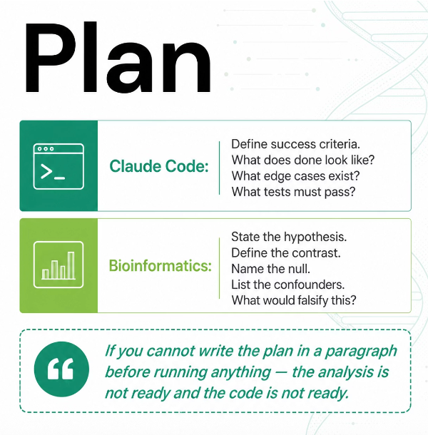
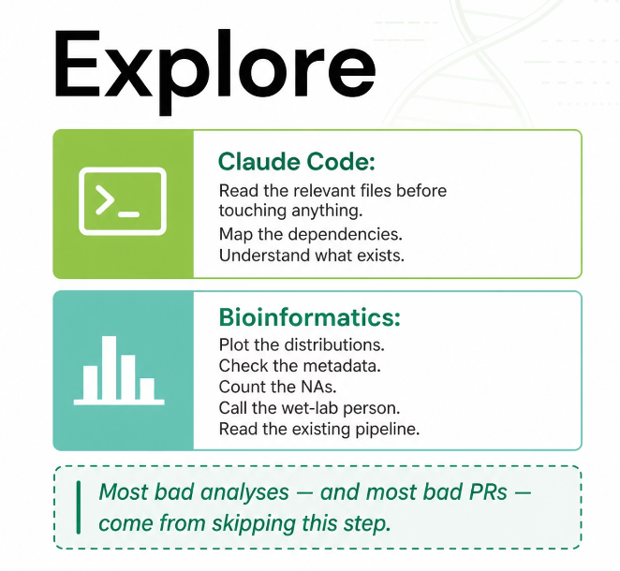

Slide 15
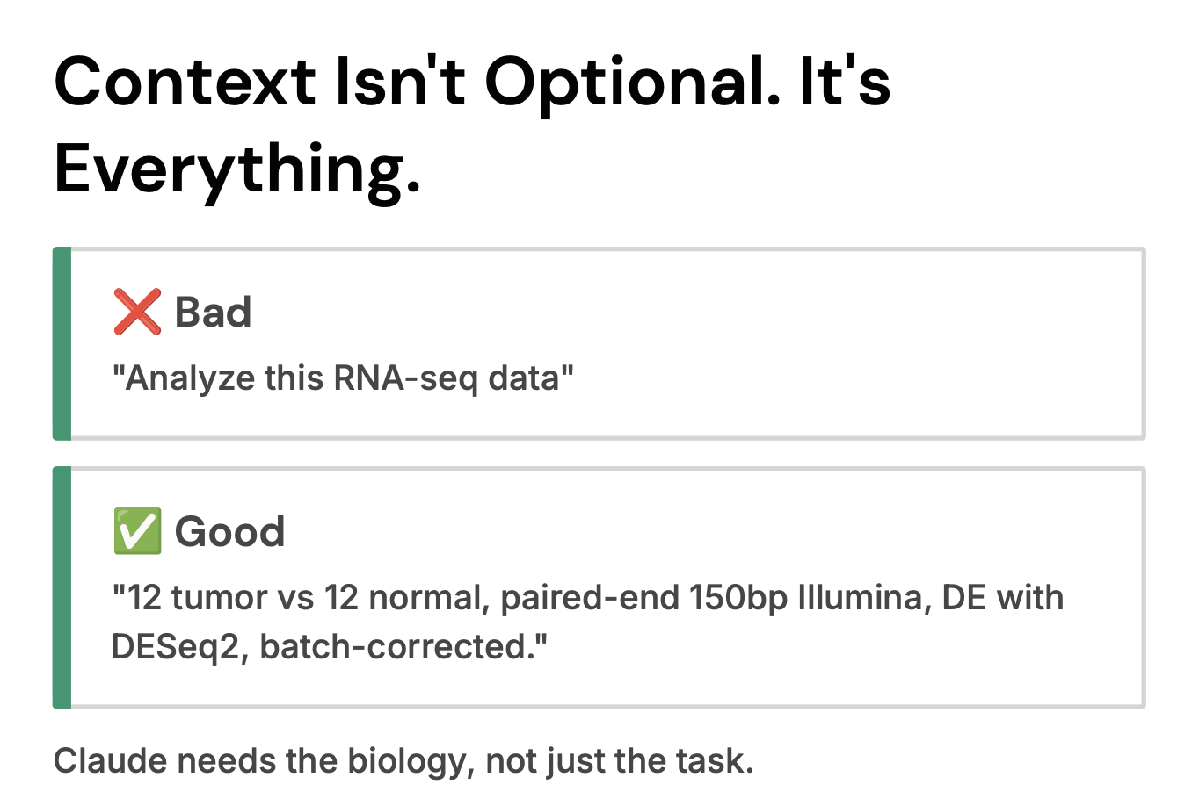

Slide 16
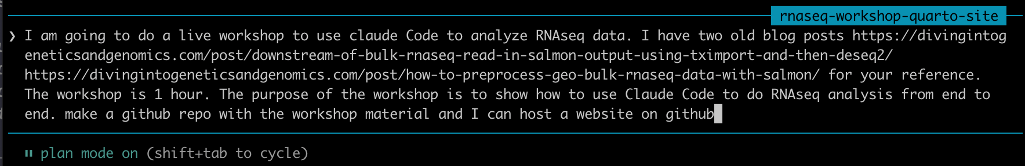
Always start with a /plan
Give Claude all the context: PPT, PDF, data and web links

Slide 17
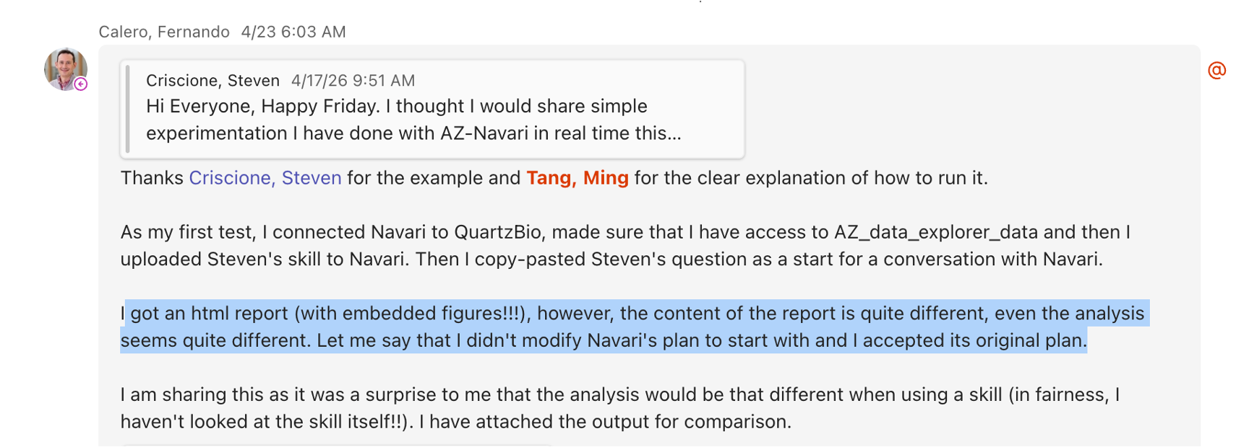
AI generated analysis is not reproducible

Slide 18
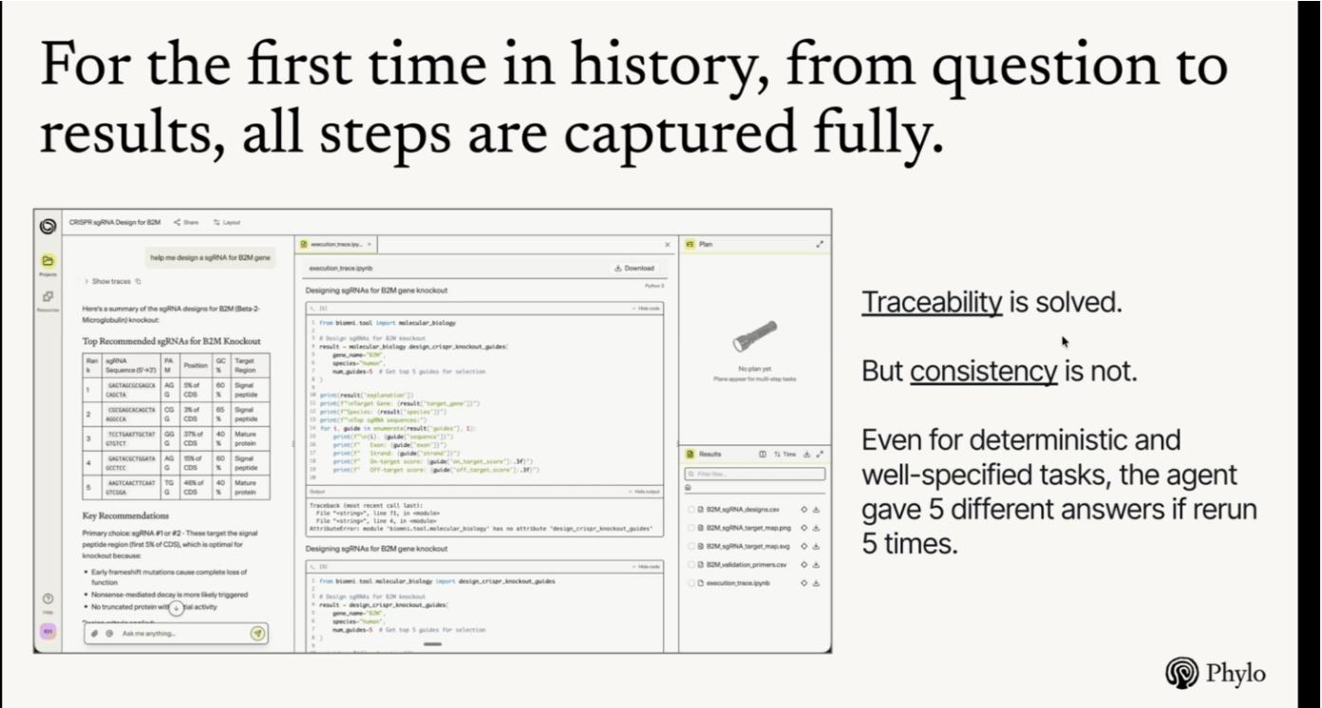
Traceability and Reproducibility are two different questions
From the Biomini

Slide 19
Hallucination is even more dangerous
Less reproducible is fine if you are doing exploratory analysis.
But when AI hallucinate and give you confident nonsense results!
“It hallucinated all the data!, I know the data was wrong as I had done the assessment myself; in my due diligence, I went to the source of the data and the number did not match up”

Slide 20
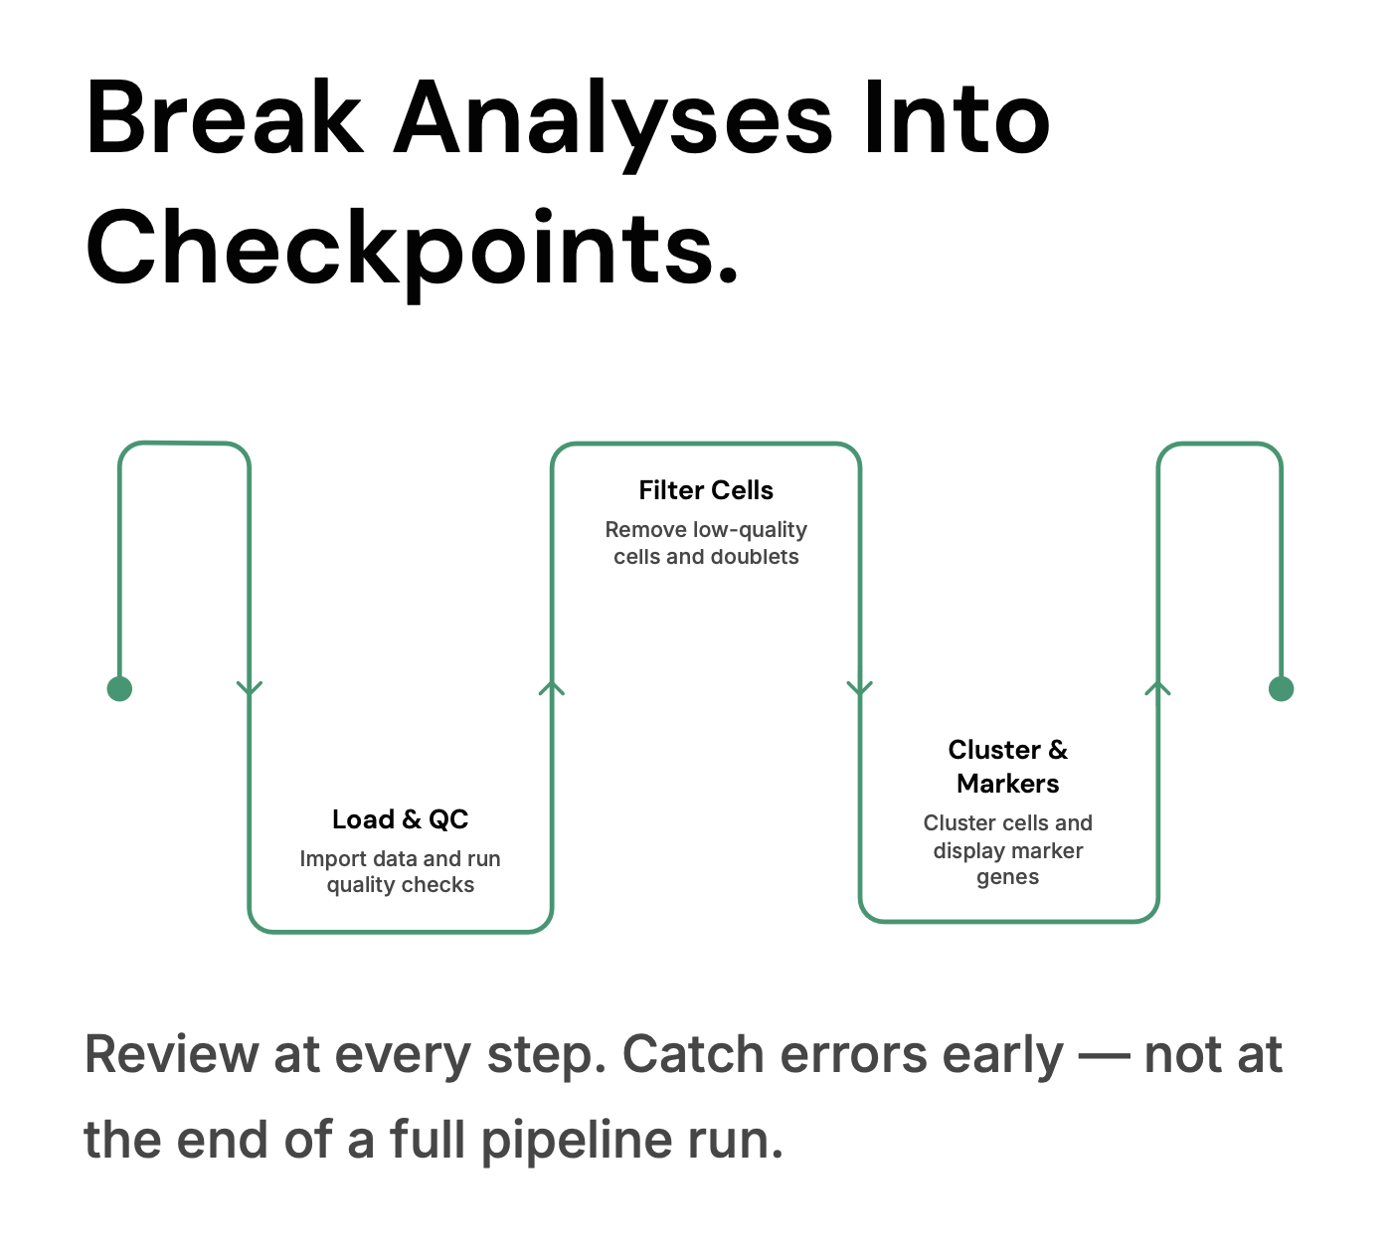

Slide 21
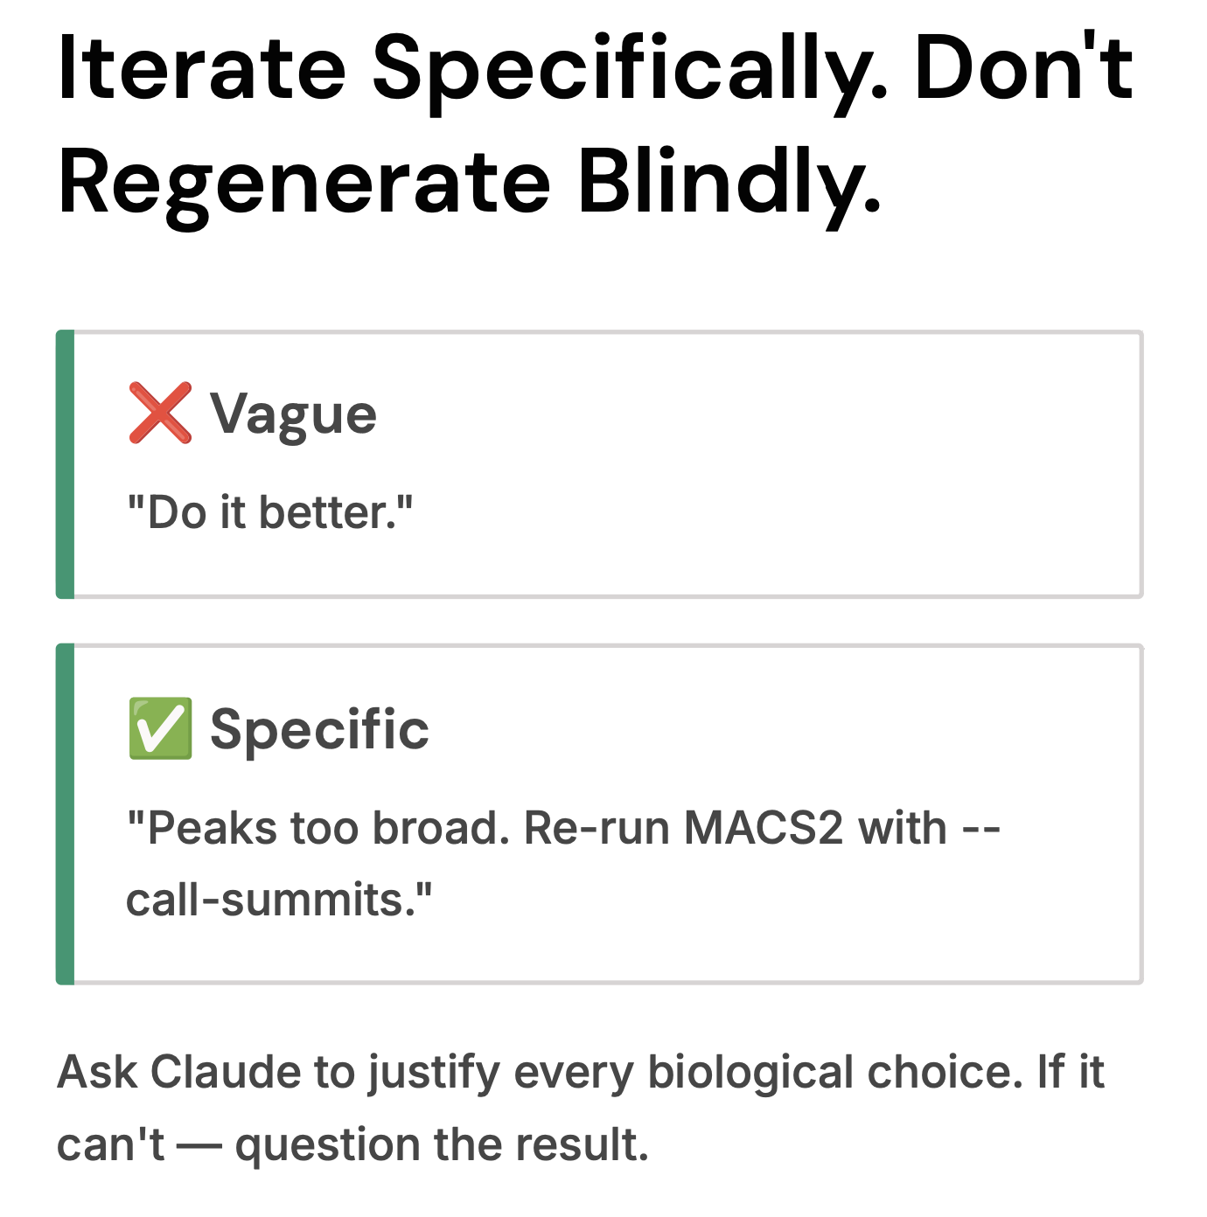

Slide 22
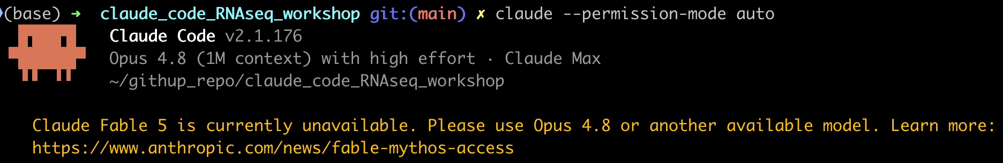
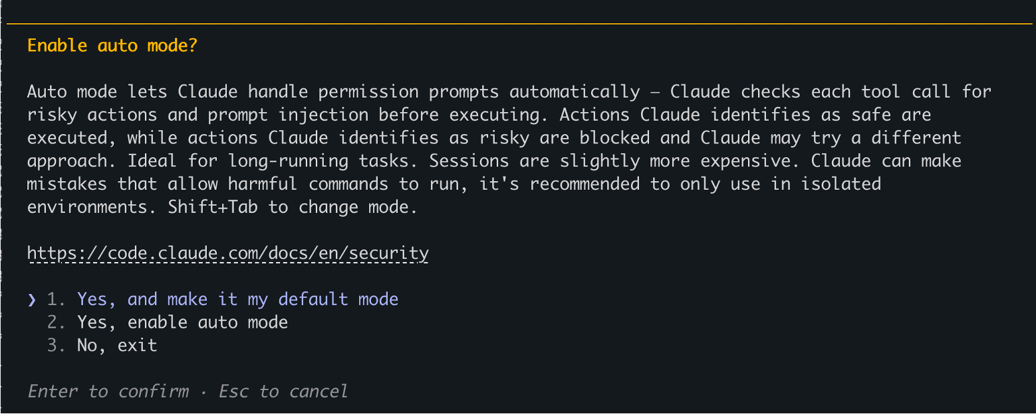
claude --permission-mode auto

Slide 23
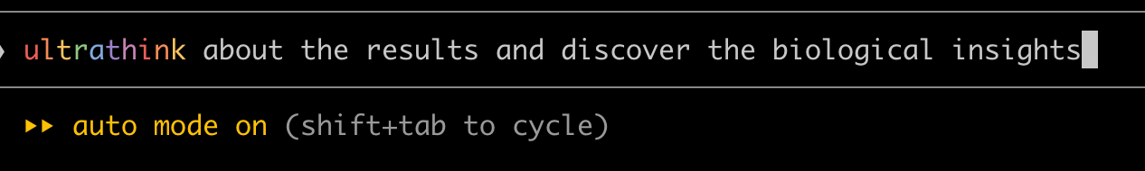
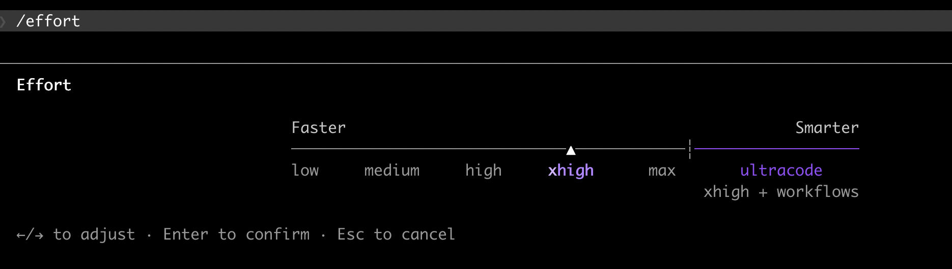
Finetune the thinking effort
•Ultrathink to increase reasoning in a specific message
•/effort to increase it for the whole session

Slide 24
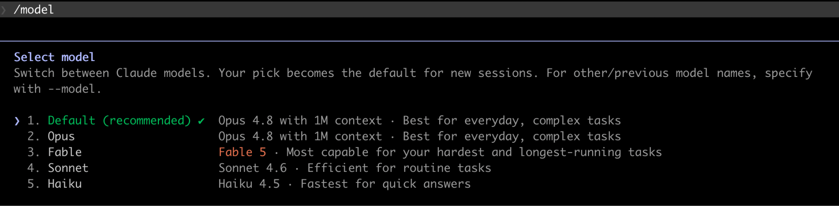
/model to select the right model for the right task

Slide 25
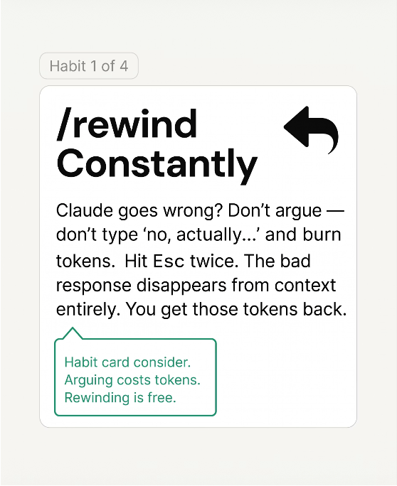
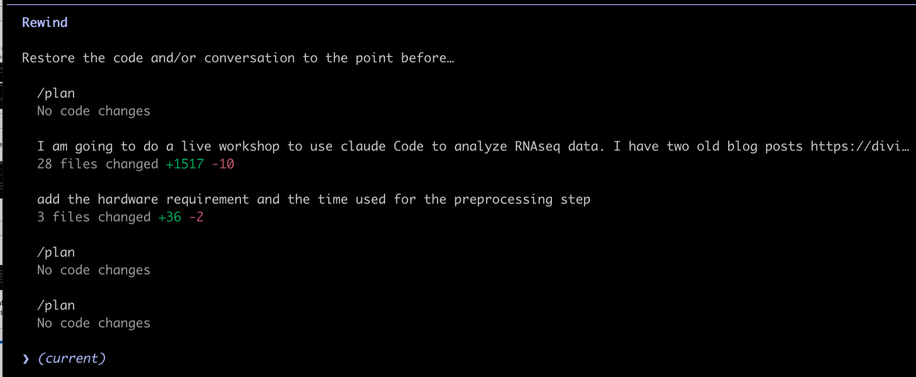
Contex management

Slide 26
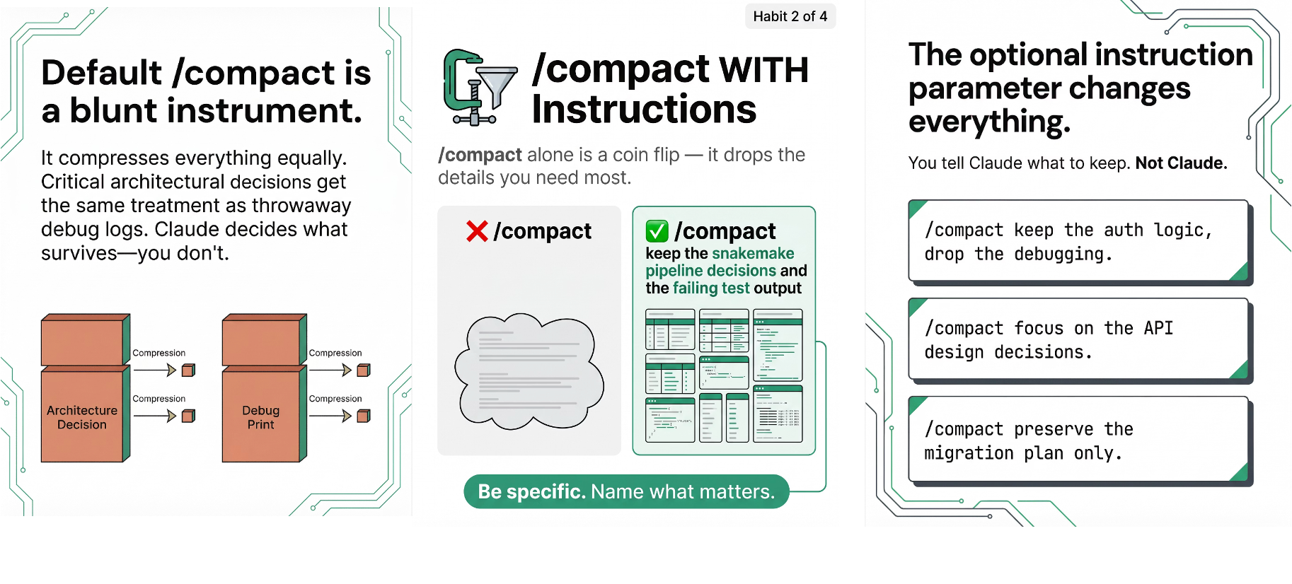
/compact with instructions

Slide 27
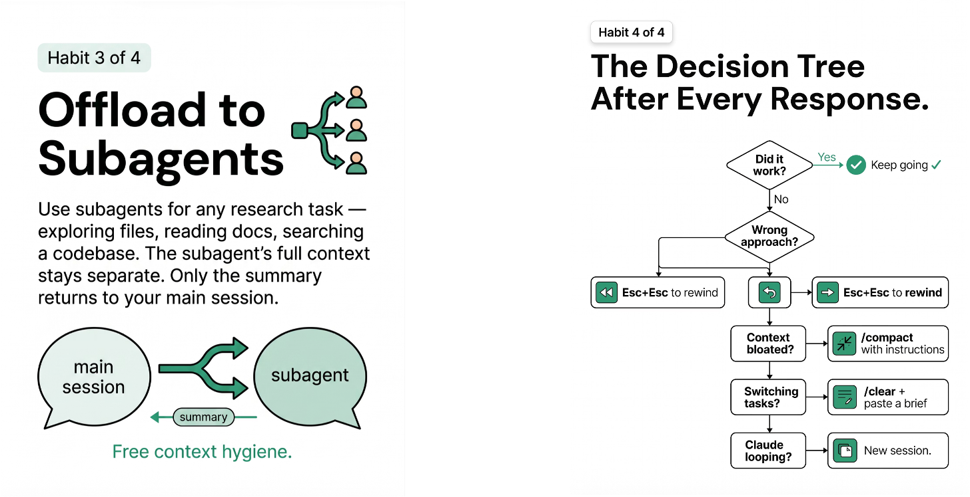
Use subagents to separate its full context with the main session

Slide 28
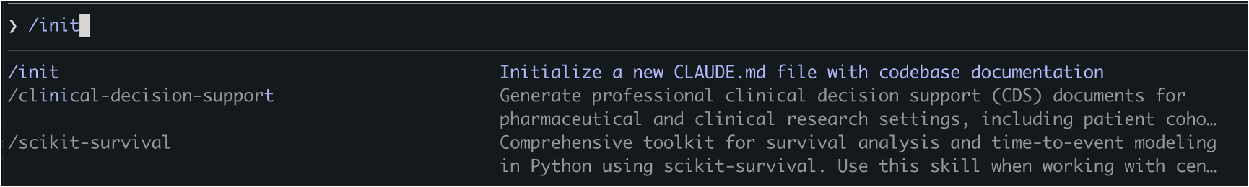
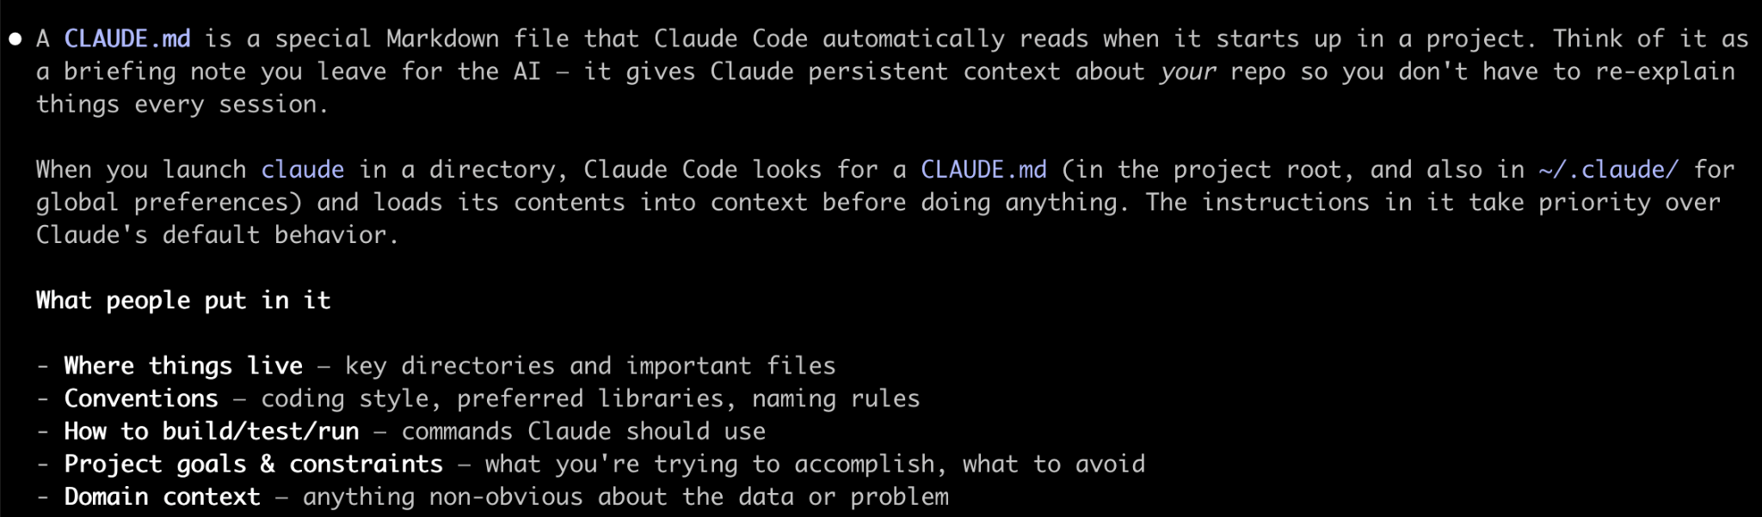
Create a CLAUDE.md file to document the code base and give instructions

Slide 29
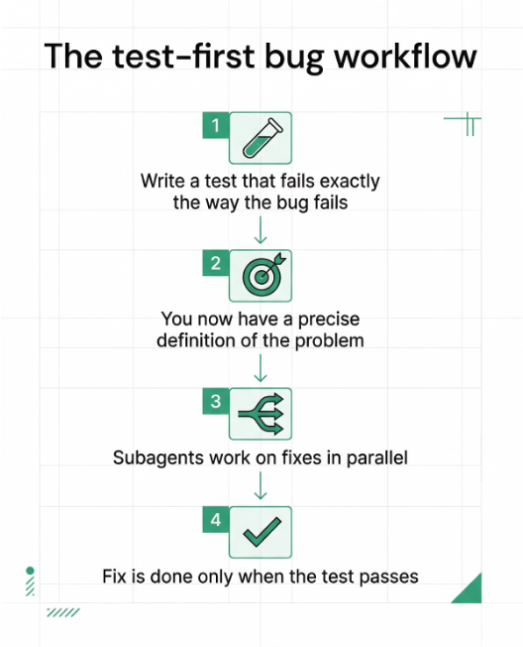
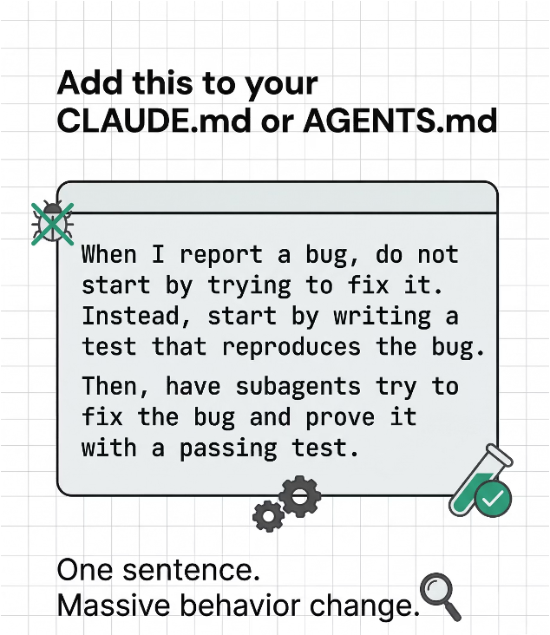
Create a CLAUDE.md file

Slide 30
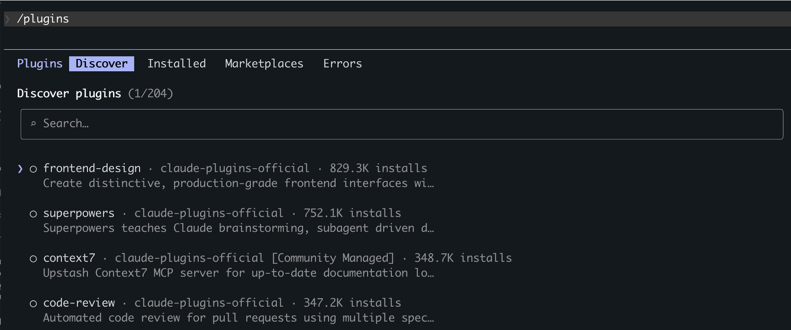
/plugins Superpowers and frontend-design for software engineer
Drastically increase the quality of your vibe coded apps. Beautiful UI

Slide 31
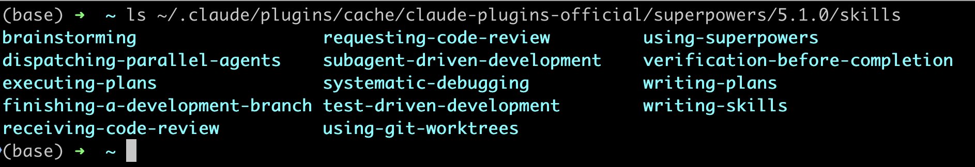
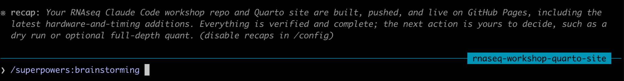
Use the plugin
A plugin can have multiple skills

Slide 32
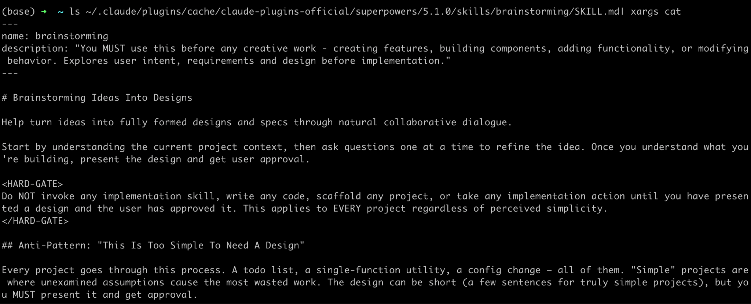
A SKILL.md is just a regular markdown file with instructions

Slide 33
Key commands we covered
•claude --permission-mode auto
•claude --resume
•/model
•/effort
•/plan
•/rewind
•/compact
•/init to create CLAUDE.md
•/superpowers and /frontend-design

Slide 34
Key takeaways from this talk
AI is powerful, embrace it
Foundation still (always) matters, master it.
AI is probabilistic, verify the results
More tips at Divingintogeneticsandgenomics.com

Slide 35
Live demo
https://crazyhottommy.github.io/claude_code_RNAseq_workshop/
https://docs.google.com/presentation/d/11SawHEDvJVSHd-juOxjL7BpNDKR4jC7H7kVZpt7biKU/edit?usp=sharing

